Slide 1
Southern MN STEM Leadership Symposium, 2018
Thomas Meagher, PhD
District STEM Education Coordinator
Owatonna Public Schools
Owatonna, MN, USA

Slide 2
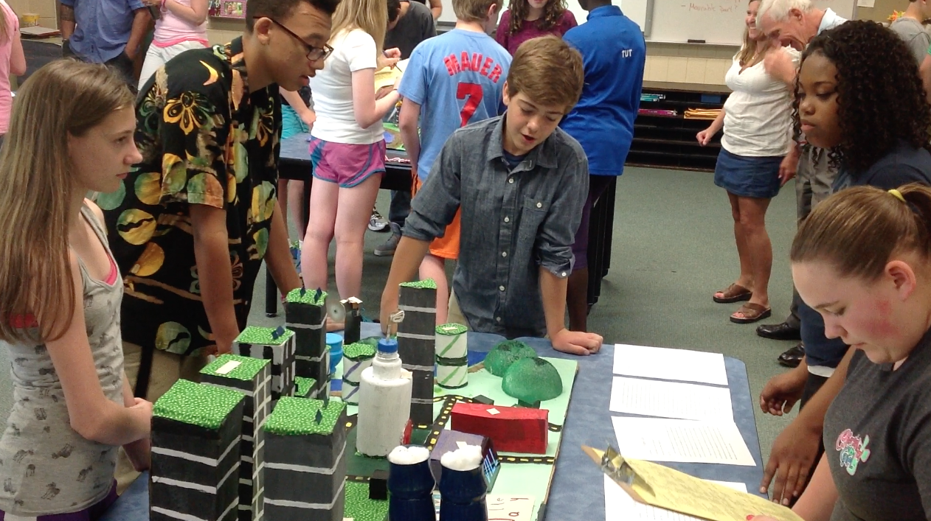
STEM is about engaging students in interdisciplinary, problem solving.
Raising questions,
Searching for answers,
Working in teams,
Arguing from evidence,
Creating solutions,
Building connections with real world learning
Indoor and outdoor shared common experiences.

Slide 3
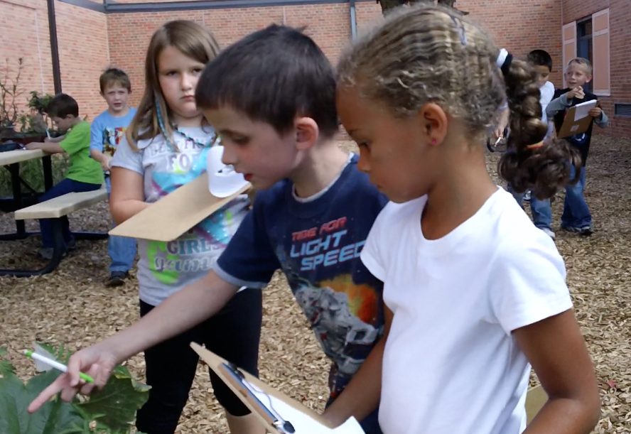
The STEM/STEAM Acronym
Reexamining STEM in the light of how effective teaching and learning occurs.
Scientific thinking, questioning and investigating: observing and collecting data/evidence
Technology use and creation to solve problems and learn skills
Engineering design and problem solving
Art is the application of human creativity and imagination.
Mathematical computation, data & pattern analysis, and interpretation
STEM is not what we teach,
it’s HOW we teach.

Slide 4
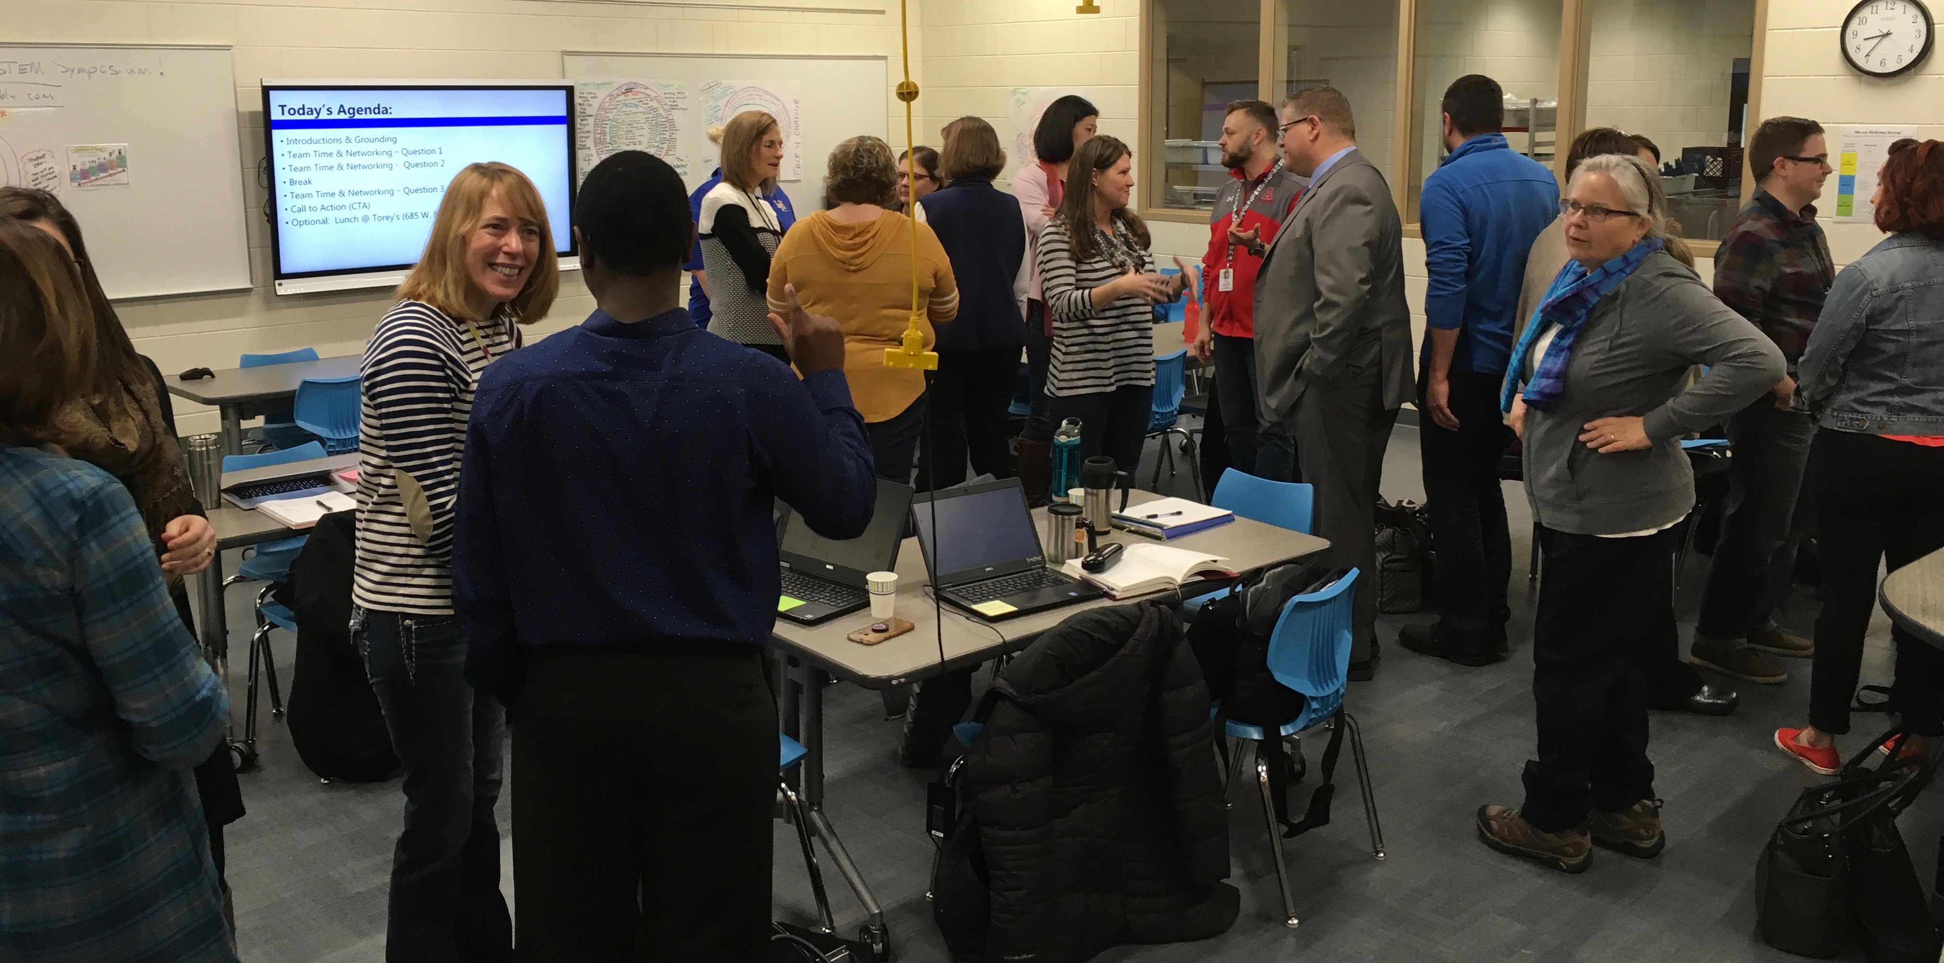
Participants in first annual STEM Leaders Symposium
Attendees included superintendents, curriculum directors, principals, coordinators and instructional coaches and post-secondary faculty from the following:
Apple Valley: Valley Middle STEM School
Austin: Holton Intermediate STEM School
Faribault-Cannon River STEM
LeSueur-Henderson: Hilltop Elementary
Minnesota State University- Mankato: elementary and secondary science education faculty
West St. Paul, Mendota Heights & Egan:
Pilot Knob Environmental School
Heritage ESTEM Middle School
Owatonna
McKinley STEAM School K-5
Owatonna Middle ESTEM School
Richfield: STEM School

Slide 5
Purpose & Essential Questions
An opportunity for STEM education leaders to share ideas, insights and network.
Where has your team been?
What learning and STEM/STEAM programming has has your team already begun?
Where is your team now?
What is your team currently doing, learning about, or implementing?
Where is your team going?
What is your vision and long-term goals for your building?
What will STEM/STEAM programming look like in the next 5- 10 years?

Slide 6
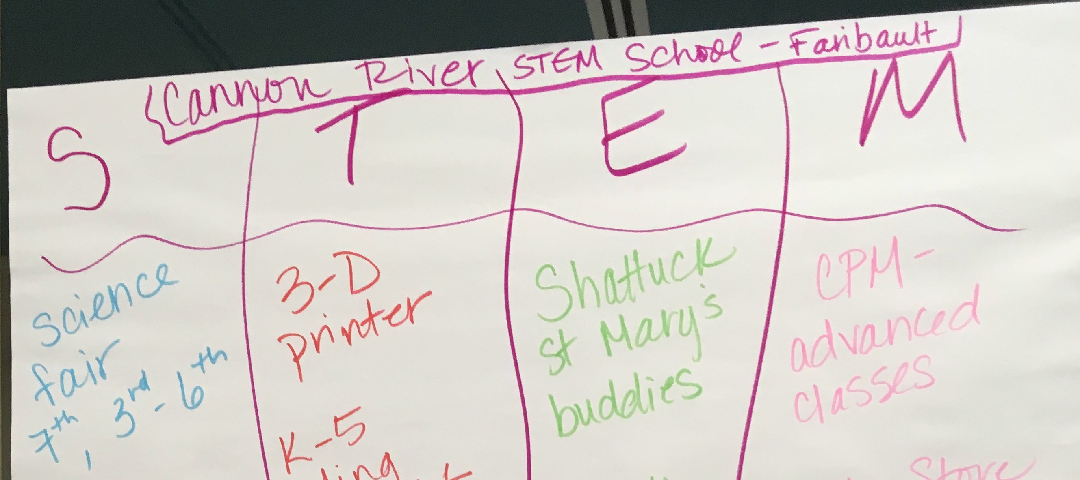
Check in with your team
Use the poster paper provided to answer these three questions for you or your team:
Where have we been as a STEM school?
Where are we now as a STEM school?
Where are we planning to be in 5 years as a STEM school?

Slide 7
Quick Summary
Varying stages of STEM implementation
Changes occurring over time due to financial resources, curriculum and staff changes
Varying degrees of integration and collaboration among faculty
STEM certification of faculty and discussion of “highly qualified”
Shared perceptions of how to move forward with STEM teaching & learning

Slide 8
Similarities in where STEM schools have been
Commitment to inquiry based science and engineering curriculum, materials and kits:
Full Option Science System - FOSS, InSciEdOut-(Zebra Fish in the classroom)
Project Lead the Way -PLTW, Engineering is Elementary -EiE & Robotics kits
Professional development for classroom teachers:
National Center for STEM Elementary Education - NCSEE
Hamline University – Lee Schmitt
U of M STEM Education Center
Jeffers Foundation – Outdoor/Environmental Education
Integration of technology either 1-1 or 1-classroom
1-1 iPads, Chromebooks or classroom carts of laptops
Special activities, events or programs at school
STEM fairs/STEM nights
Engineering challenge days/events
Advanced classes in science, technology, engineering and math

Slide 9
Where STEM ed. is now…
Focus on development of STEM/STEAM/ESTEM teaching and learning
Creating vision & mission or belief statements
Creating shared planning time for teacher teams-curriculum integration
Building flexible programs/classes/curriculum schedules
Building collaborative teacher teams that include specialists
Providing students voice and choice in lessons, classroom environment & instruction
Building community partnerships
Publish effective STEM teaching and learning practices through participation in state, regional and national conferences
Engagement with post secondary institutions through student teacher partnerships and continuing education.
Building capacity of teachers and students
Development of leadership cohorts of teachers
Instructional support with onsite instructional coaching

Slide 10
Where we are now cont.
Support for teaching and learning continued:
Provide support for instruction through integration sub-out days and common prep time for grade level teacher teams.
Provide continuous PD for both new and veteran teachers.
Proving student enrichment:
STEM-based extra curricular clubs, activities or competitions
Community based mentorship in STEM extracurricular activities.

Slide 11
Where we want to go…
Development of shared vision and mission for STEM teaching and learning.
Creating shared vision/mission or belief statements school wide
Create a culture of STEM teaching and learning as a teaching philosophy among faculty
Bring STEM as a philosophy of instruction and method of understanding the world within which we live.
Working to reduce the constraints of current challenges.
Financial resources to provide time for collaboration, creativity & professional development.
School schedules that provide time for student choice and teacher voice in lesson plan design.
Building the capacity of STEM school & school districts
Create a shared resource hub for schools/teachers/students
Build shared vision of STEM teaching and learning among like schools and districts
Have annual events to bring like minded schools and districts together to share new ideas in STEM education
Build partnerships & communication across P-20 STEM education

Slide 12
Next steps
Sharing ideas and resources
Development of a central hub to build a consortium
Sharing curriculum, instructional strategies and collaborating on new ideas
Annual meeting to share results and celebrate advancement of STEM teaching & learning
SoMN STEM Consortium: https://somnss.weebly.com/

Slide 13
Questions?

