Slide 1
STEMify Your Teaching Best Practices of STEM Education in Your Classroom
Thomas Meagher, PhD
District STEM Education Coordinator
Michelle Simon, 1st grade teacher McKinley Elementary STEM School
Kayla Davis, 3rd grade McKinley Elementary STEM School
Libby Zeman, Literacy Instructional Coach McKinley Elementary STEM School
Josh Tolle, 6th grade Willow Creek Environmental STEM (ESTEM) School
Owatonna Public Schools
Owatonna, MN

Slide 2
The status of STEM Education in MN
Results of how students taking the ACT fared based on interest and performance in STEM fields on 2015 ACT exams.
Differences in student interest and academic performance shows more divergence when examined by ethnicity.
Results of this study did not explore if students had previous schooling in STEM.

Slide 3
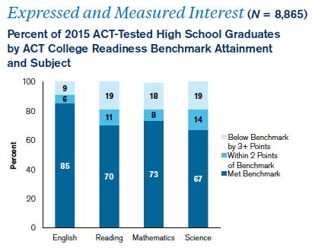
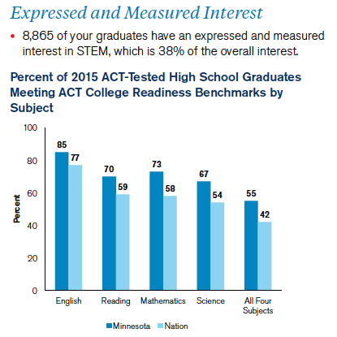
Minnesota College Readiness

Slide 4
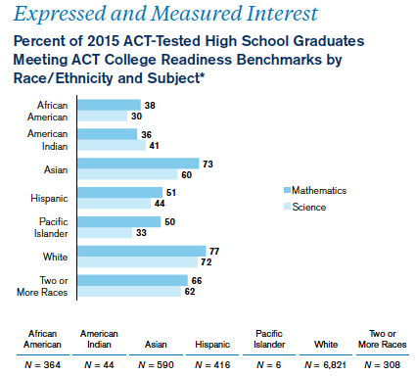
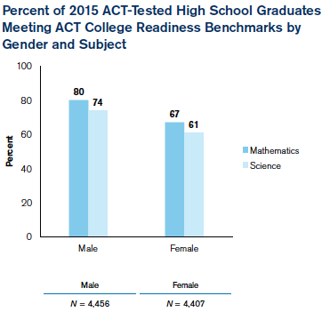
MN ACT data: ethnicity & gender
Key findings:
Interest in STEM remains high, almost 49% of students taking ACT expressed interest.
ACT Achievement levels are highest when students have both expressed and measured interest in STEM content.
Female interest in STEM areas is high.
Achievement levels in math and science need to improve.
Interest in teaching STEM is declining, ACT is calling for well prepared STEM teachers!

Slide 5
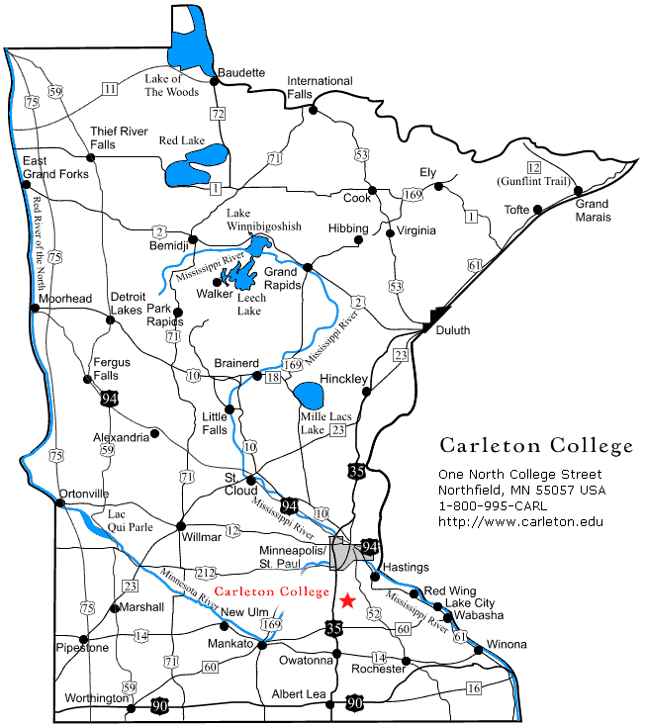
Demographic data for Owatonna STEM Schools:
African 11.7%
Asian 1.6%
Hispanic 12.1%
White 74.6%
~ 15% English Language Learners
~ 53% Free and Reduced Lunch

Slide 6
Models of STEM Teaching & Learning
Science, technology, engineering and math are taught, but are separate subjects.
Science
Technology
Engineering
Math

Slide 7
STEM subjects are integrated.
Science
Technology
STEM
Engineering
Math

Slide 8
STEM is embedded in all subject areas
STEM Curriculum
Technology
Math
Science
Engineering

Slide 9
The position of STEM within science education literature
Nationally, there are multiple definitions of STEM education with no clear defined description. However, researchers are calling for investigation into integrated STEM Teaching and Learning (English, 2016; Weld et. al, 2015; Saxton et.al, 2013)
Since STEM educational initiatives are new for Minnesota schools, investigating their impact on teaching and learning is a bourgeoning field of research (Gibson & Chase, 2002; Breiner, Harkness, Johnson & Koehler, 2012).
It is important to understand student attitudes of how they perceive the experience of learning through STEM and the impacts of collaborative inquiry and integrated science, technology, engineering and math curriculum (Matson, DeLoach, & Pauly, 2004; Becker & Park, 2011).

Slide 10
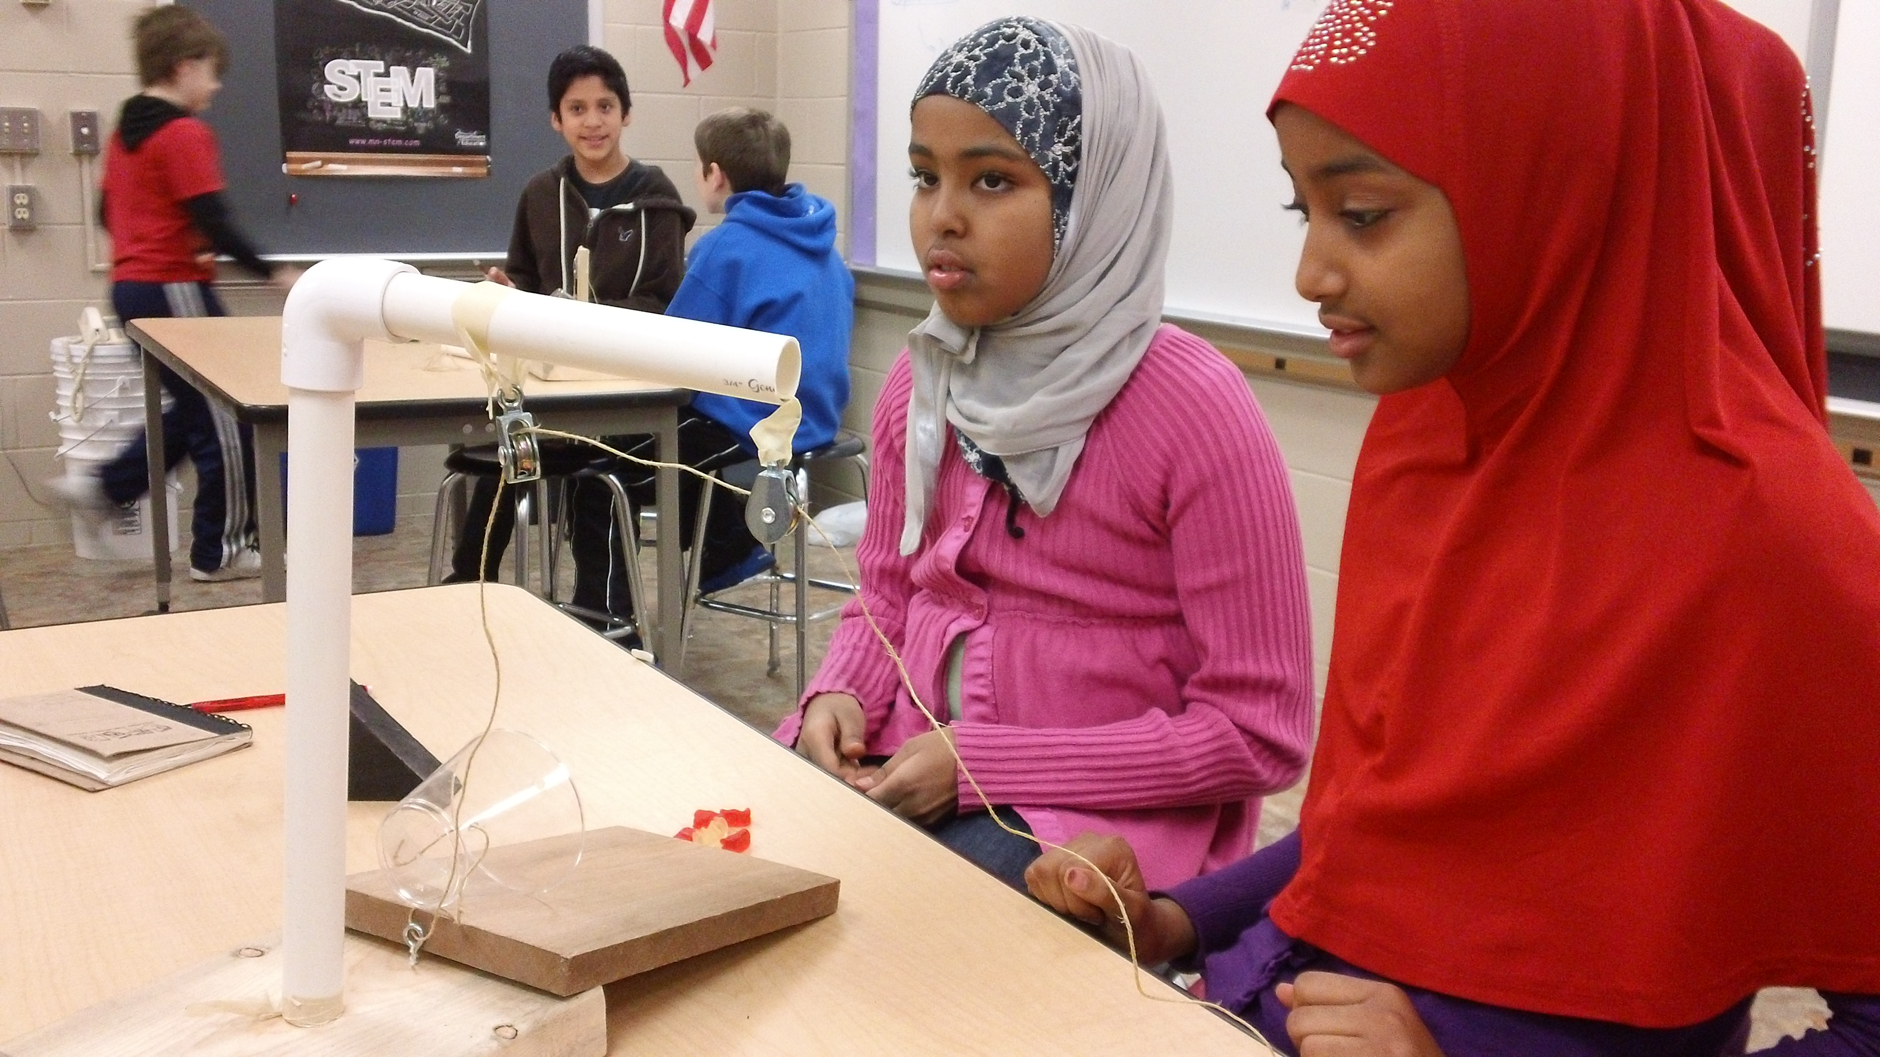
What STEM means in Owatonna
Teaching of STEM emphasizes integrated lessons where students solve problems and engineering challenges in all classes.
STEM is embedded among all subject areas where all students can learn rigorous academic subject matter.
Classes focus on students developing growth-mindsets and making mistakes is the launching point for real learning.
Students recognize that lessons relate to real world learning.

Slide 11
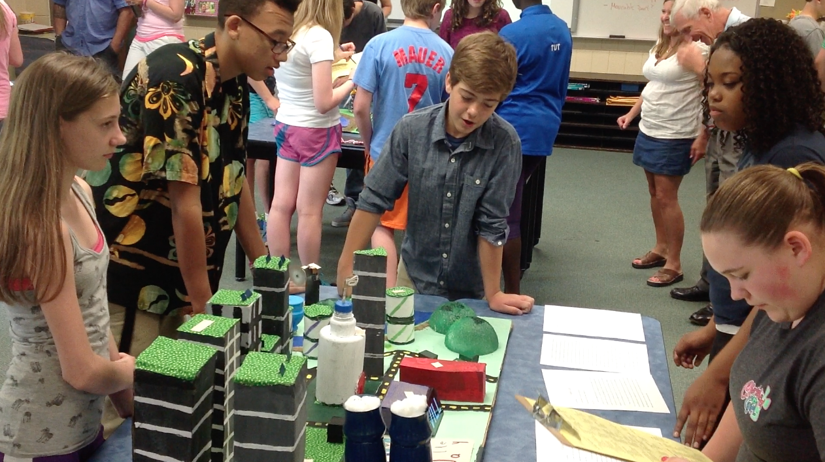
Developing an Owatonna STEM model
Lessons are designed for using STEM notebooks/journals to promote: STEM literacy & STEM fluency
However, shared STEM experience is essential to develop literacy and fluency skills.
We want students to show-off their work. This allows for multiple forms of student dialogue and publication.
When all these ideas are combined a STEM teaching and learning emerges:

Slide 12
A teaching/learning model for Owatonna STEM Schools
STEM Experience
Show-it Show-it Show-it
Do-it
Say-it
Write-it
Read-it
STEM
Literacy
STEM
Fluency

Slide 13
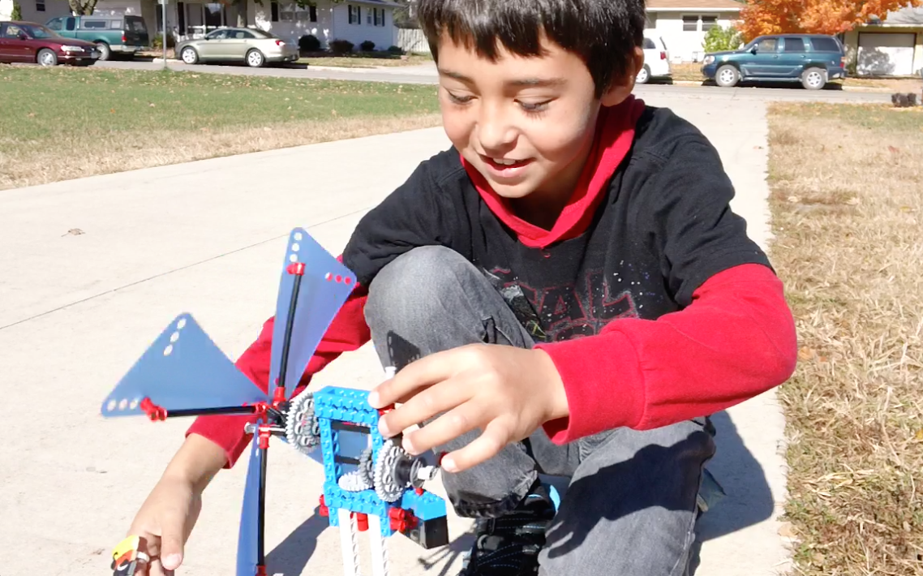
STEM model guides teaching and learning in all content areas such as:
Art & Perpich Foundation: Integration of Arts into STEM lessons at all grade levels. Art teacher, Amanda Gislason, works closely with teachers K-5 to create integral art embedded STEM units.
Environmental Education: “ESTEM”: Builds STEM learning on a foundation of environmental principles examining how society, culture and ecosystems interact.
Special Education: Integrating STEM into IEP and inclusion learning creates opportunities for differentiation.
ELL: Using STEM experience for front loading language development.
NEXUS: Using STEM to address social & racial achievement gaps in student learning.
PAGE: Addressing gender equity through STEM teaching and learning.
Physical Education & Music: incorporate incorporating science and engineering into lessons.

Slide 14
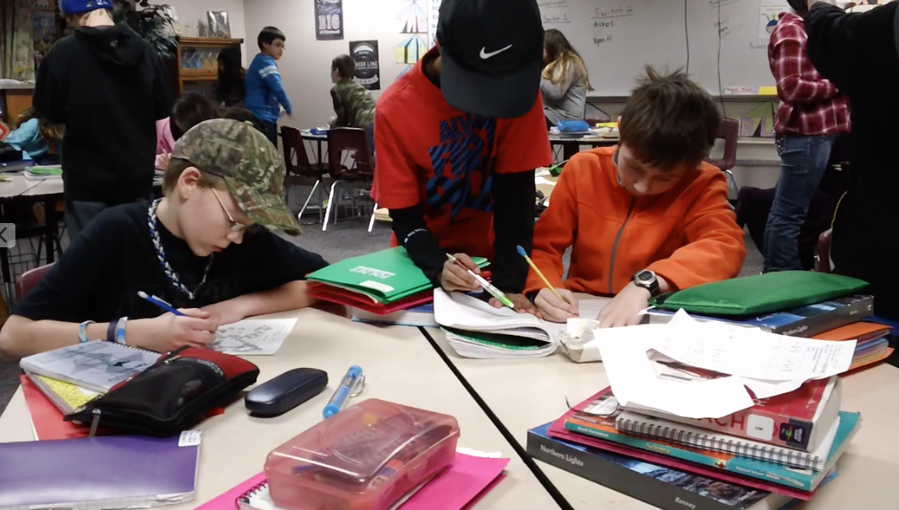
STEM is about engaging students in interdisciplinary, problem solving.
Raising questions,
Searching for answers,
Working in teams,
Arguing from evidence,
Creating solutions,
Building connections with real world applications both indoor and outdoor
Experiencing shared common experiences.

Slide 15
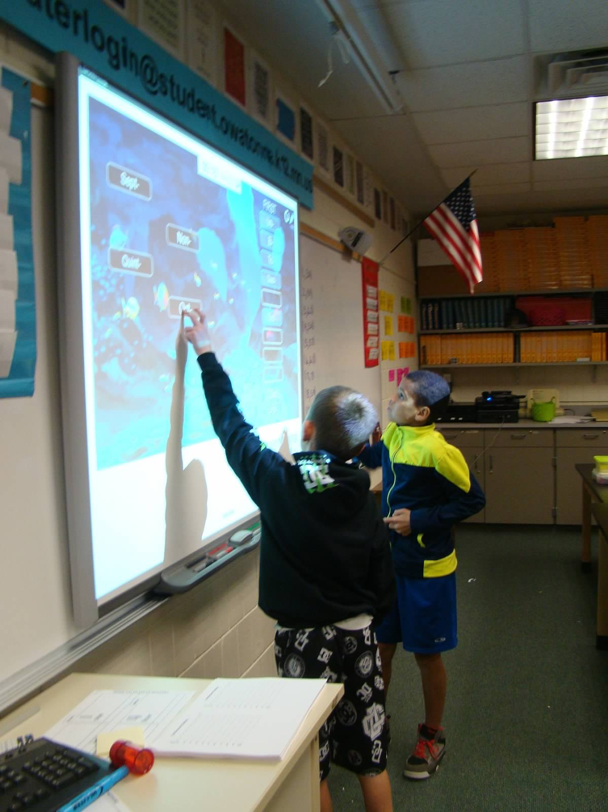
The STEM Acronym
Reexamining STEM in the light of how effective teaching and learning occurs.
Scientific thinking, questioning and investigating
Technology use and creation
Engineering design and problem solving
Mathematical computation, data analysis and interpretation
S+T+E+M=Learning

Slide 16
8 Elements of a STEM School (University of Chicago STEM School Study, 2015)
Problem-based Learning – Interdisciplinary Instruction, Student Reflection, Student Autonomy
Rigorous Learning – Real-world Content, Staff-created Curricula, Cognitively Demanding Work
School Community and Belonging – Atmosphere of Respect, Induction of New Students, Extracurricular Activities
Career, Technology, and Life Skills – Early College Activities, Technology use by Students, Practice of Communication/Life Skills
Personalization of Learning – Differentiation, Follow Student Interests, Use of Formative Assessments
External Community – Community Presence, Service Learning, Teachers Sharing Practices
Staff Foundations – Collaboration, Reflection, Leadership
Essential Factors – Flexible/Open to Change, Representative Student Population, Professional Development

Slide 17
How we design & build effective STEM teaching & learning
Teachers work in collaborative grade level teams with shared prep times (usually).
Bi-weekly PLC meetings that focus on data collected from formative & summative assessments.
Sub-out days during the school year provide for common & creative planning to “STEMify” our curriculum.
Continual PD with resources such as Jeffers Foundation, Perpich Foundation for Arts Integration, National Center for STEM Elementary Education, & University of MN STEM Education Center.

Slide 18
Questions?

Slide 19
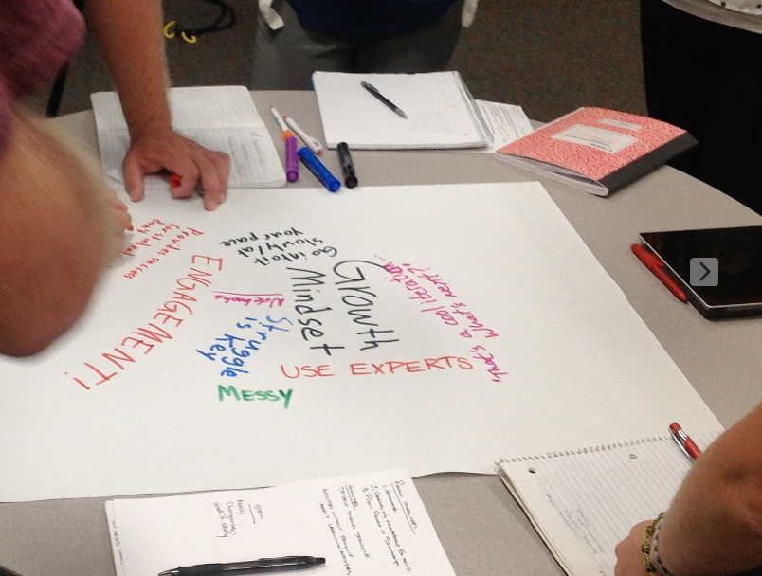
Working with Owatonna STEM Teachers
Four stations, each for different grade levels
Teachers have brought materials from their classrooms to share and discuss
Each station will be focused on discussion, question answering and dialogue:
Michelle Simon, 1st grade teacher: Focus group K-2 & STEM Certification through the NCSEE @ St. Kate’s University
Kayla Davis, 3rd grade: Focus Group 3-4 & Technology integration
Libby Zeman, Literacy Instructional Coach: Focus group 4-5 & Literacy K-5
Josh Tolle, 6th grade: Focus group:
6-8 Science, Literacy, Access & Equity through the Science Museum of Minnesota PAGE program

Slide 20
Responses to student attitudes towards STEM Education survey
Mean scores from grades 4-8 for students responses of “Agree to Strongly Agree”:
“I am good at math” : 70.2%
“I know I can do well at science.”: 68.6%
“I believe I can be successful at engineering.”: 57.2%
“Knowing how to use math and science together will help me invent useful things.”: 66.9%
“I am confident that I can produce high quality work.”: 74.0%
“I can work well with students who are different from me.” 80.0%

